Slide 1

Presentation on Placement Management System
UNDER THE GUIDENCES of
Prof CHITRaNJAN
Technical Trainer
Edubridge
(School of coding)
SUBMITTED BY
Trupti Lokhande
BE
Batch:EON-5759
Center: Thane

Slide 2
ABSTRACT
Placement Management System The main objective of Placement Management System is to develop software which manages placement activities in college and also off campus makes an interactive where Placement management system can manage the details of all students on his console, he can send an email to students informing about placement activities. This project mainly aims for jobless students.

Slide 3
INTRODUCTION
The Project titled “Placement Management System ” is software system allows the students to create their profiles and upload all their details including their marks onto the system.
PMS which helps out the HR Personal in the recruitment of new candidates to the company and helps the recruitment process as a whole.
A college Placement Management System that consists of a student login, company login and an admin login.
PMS handles student as well as company data and efficiently displays all this data to respective sides.

Slide 4
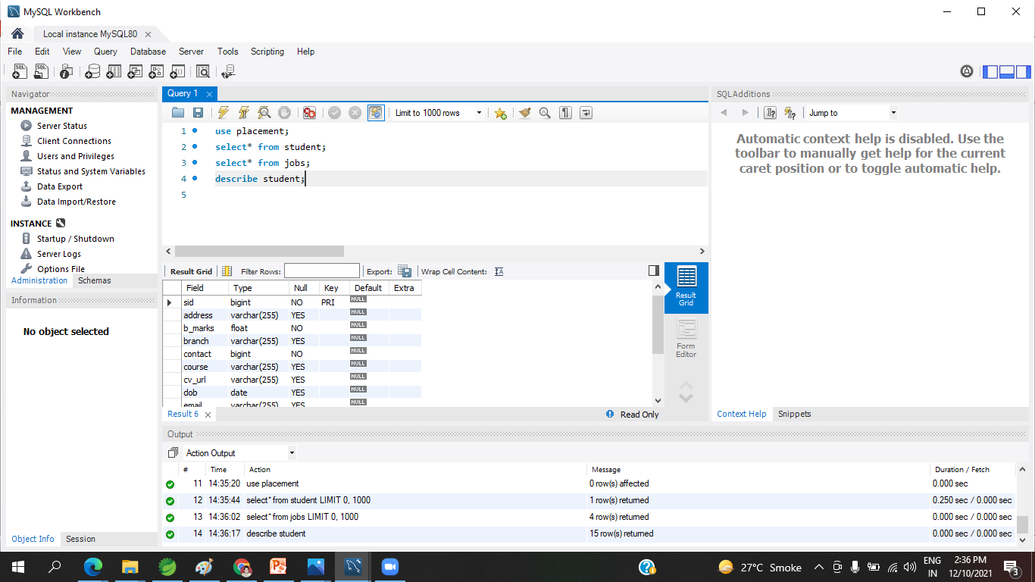

Data Dictionary Student database RECRUITER DATABASE

Slide 5
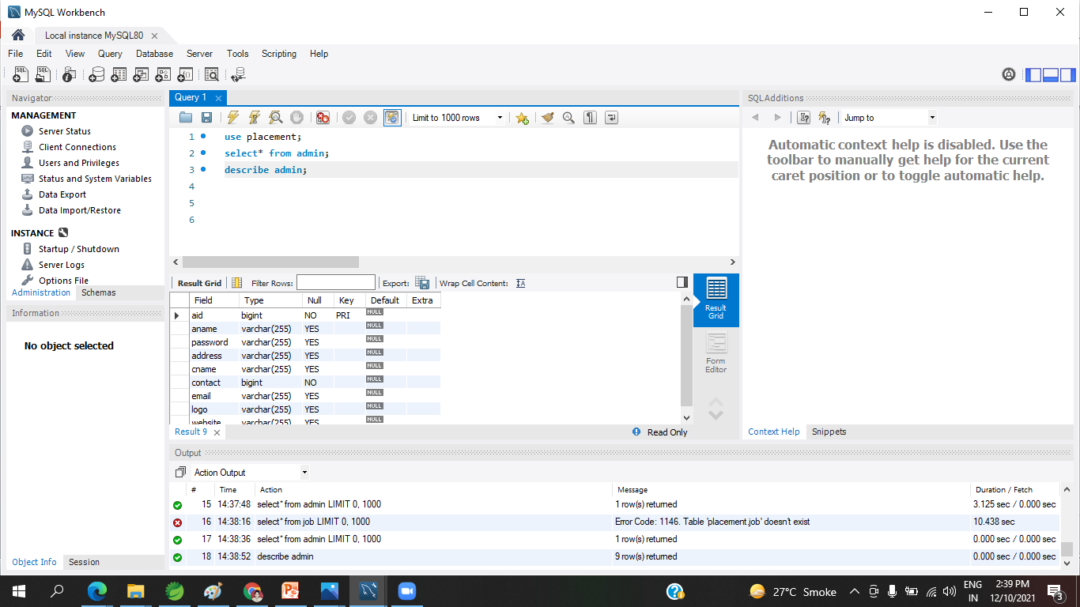
Data Dictionary ADMIN database JOBS DATABASE

Slide 6
System requirements
Hardware Requirement:-
Software Requirement:
i5 Processor Based Computer
1 GB-Ram
5 GB Hard Disk
Monitor
Front End: HTML, CSS, JavaScript, Spring boot
Back End: MySQL workbench8.0.CE
Middleware/Server: Apache Tomcat v.8.5, IDE: Spring Boot
Browser: Google Chrome
Windows10 operating system

Slide 7
MODULE DESIGNED
Home Page
Admin Portal
Recruiter Portal
Student Portal

Slide 8
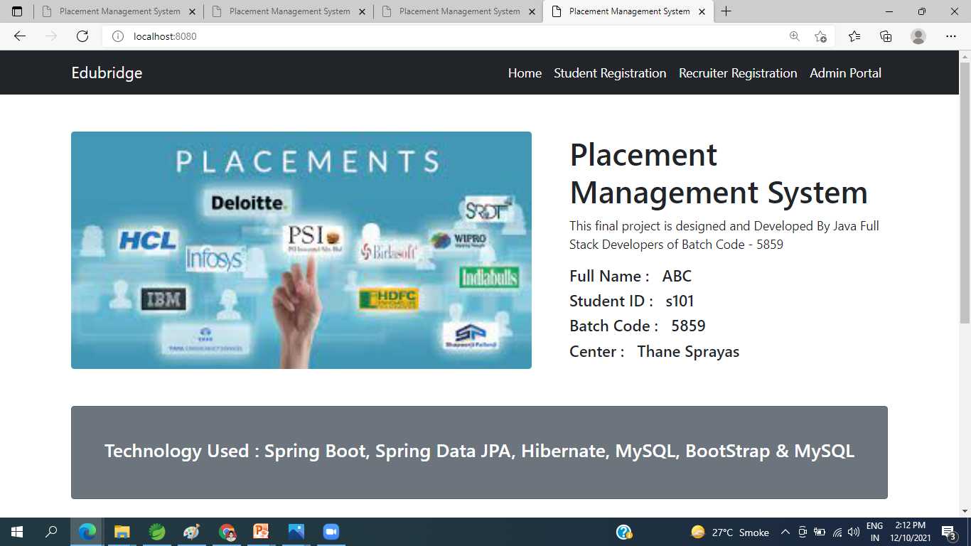
Home page

Slide 9
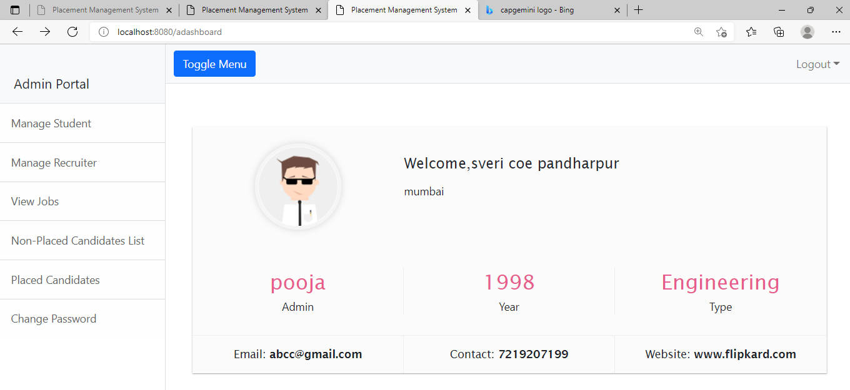
admin Portal

Slide 10
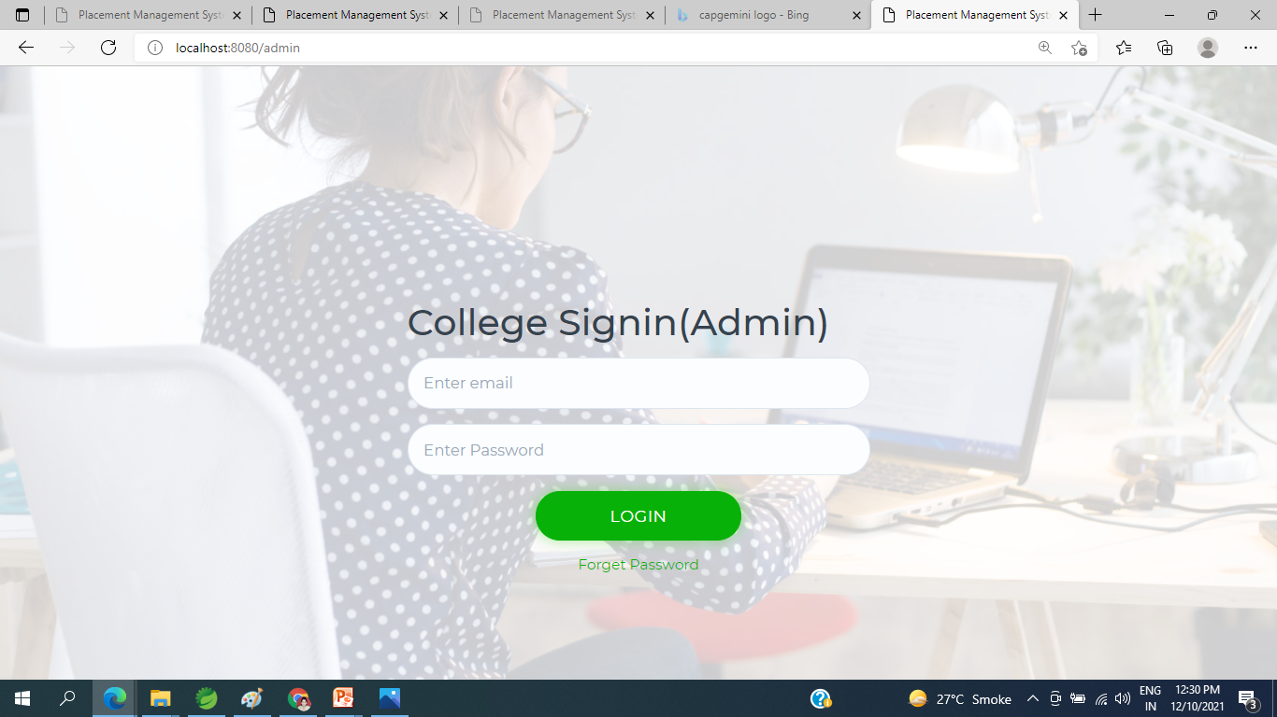
Admin sIGNIN

Slide 11
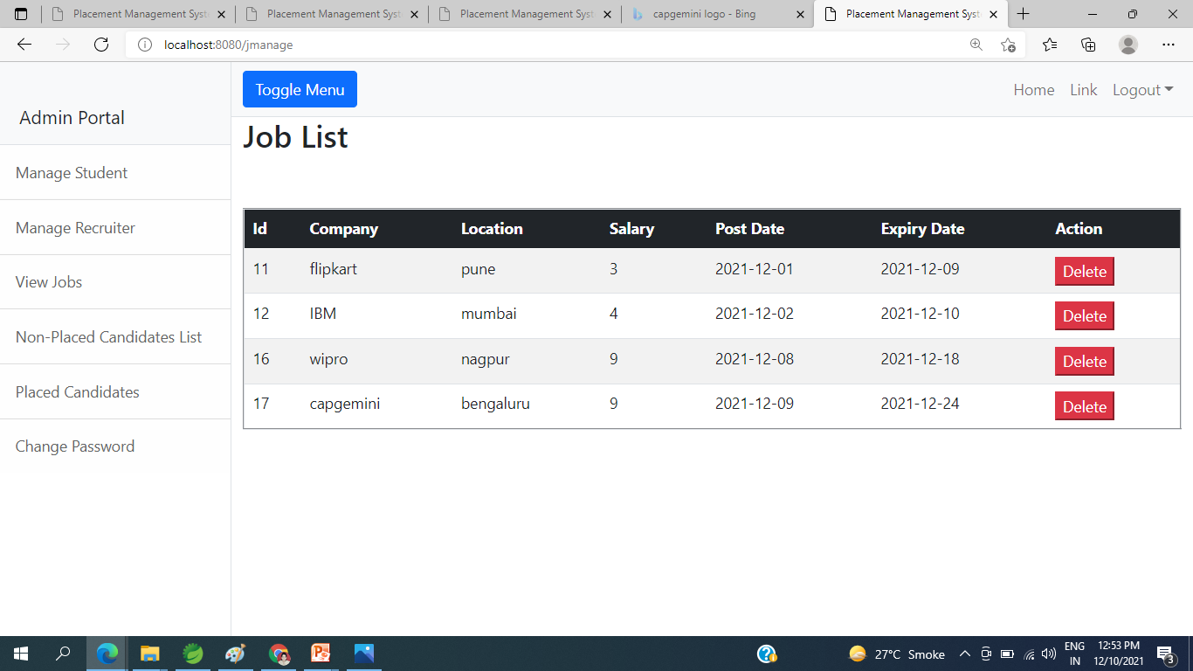
Admin portal job LIST

Slide 12
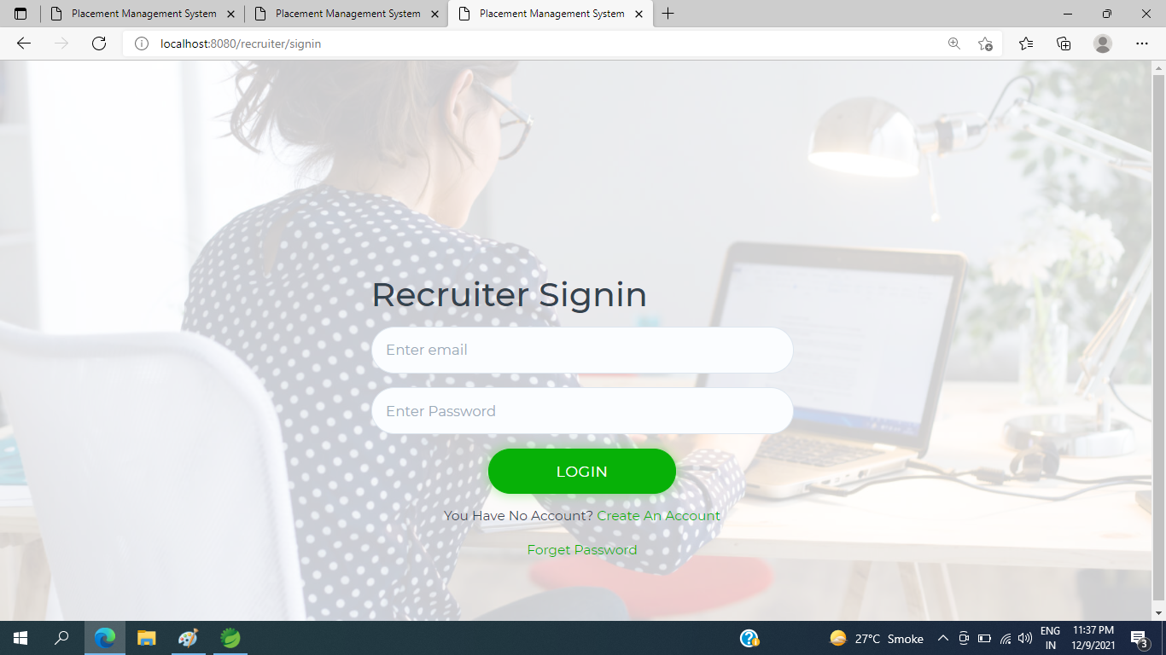
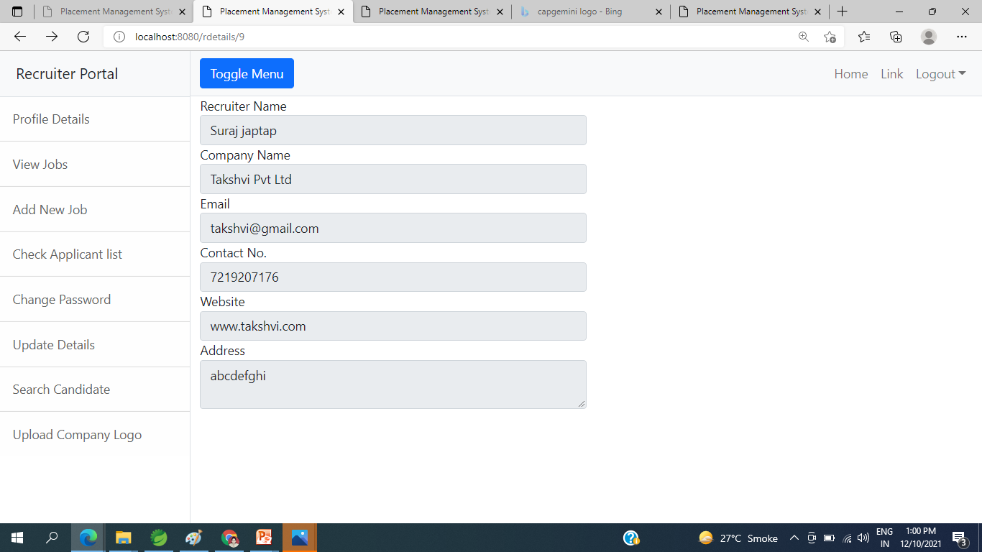
Recruiter sign-in and signup page

Slide 13
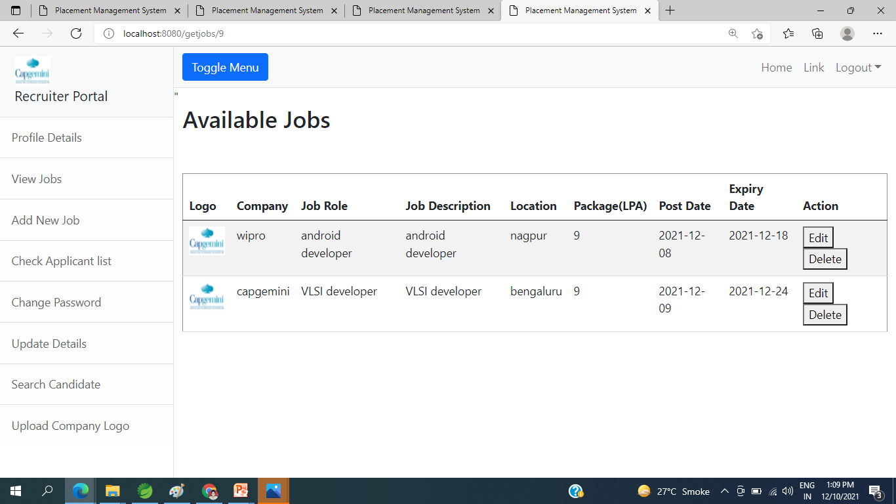
RECRUITER PORTAL view jobs

Slide 14
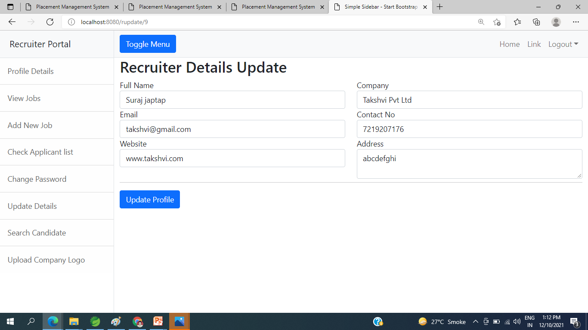
Recruiter portal update details

Slide 15
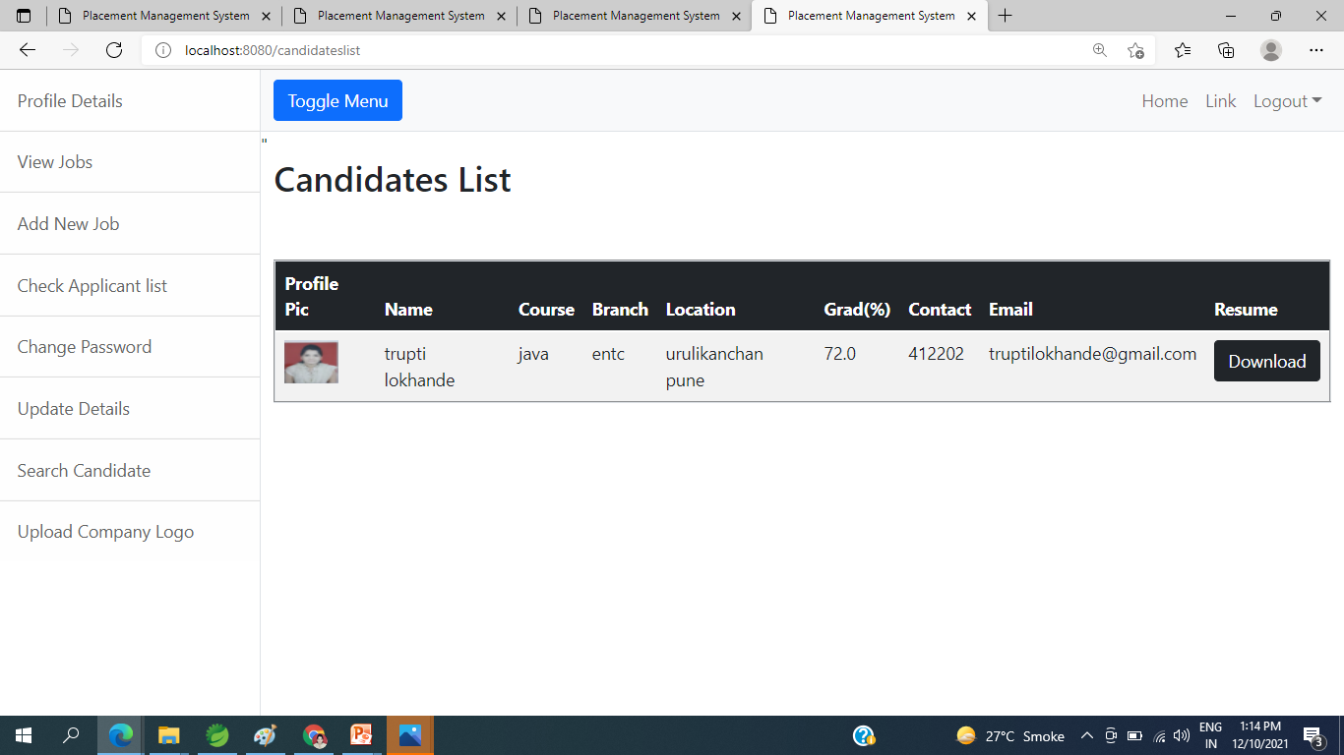
Recruiter portal search candidate

Slide 16
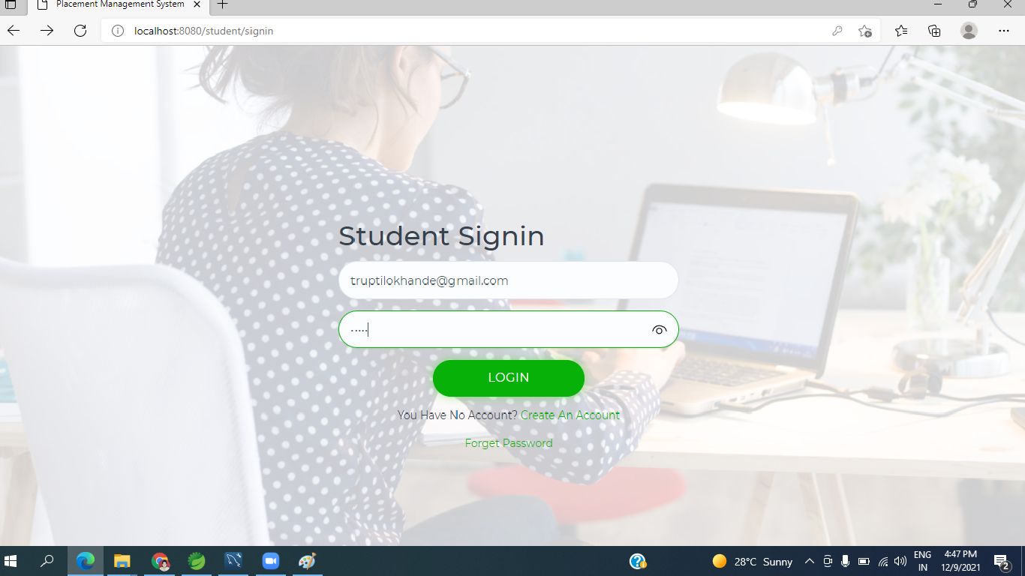
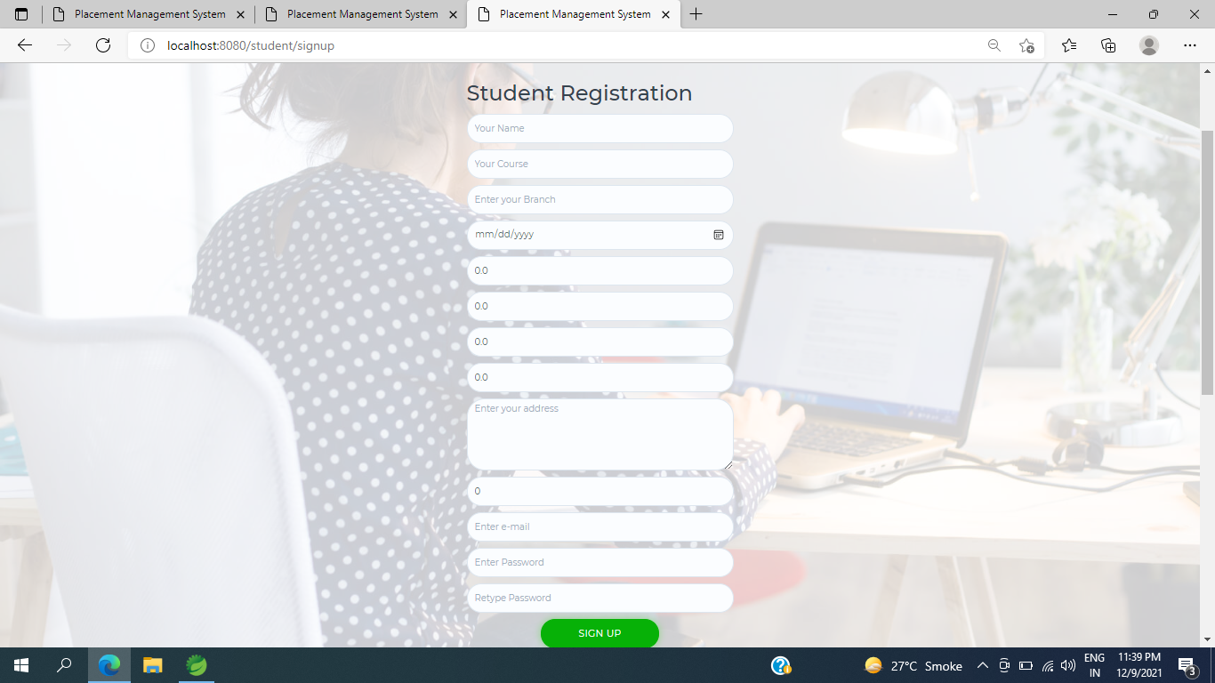
Student sign-in and signup page

Slide 17
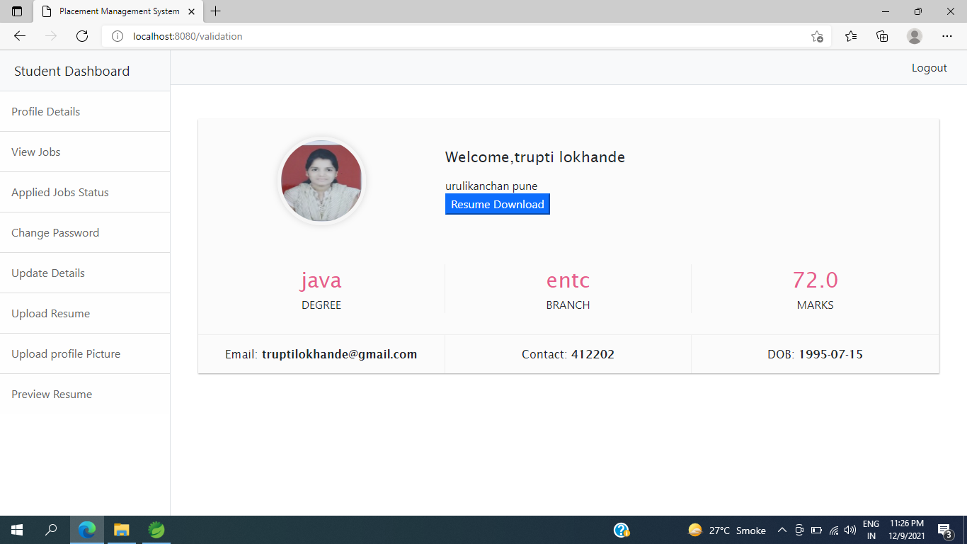
student portal student dashboard

Slide 18
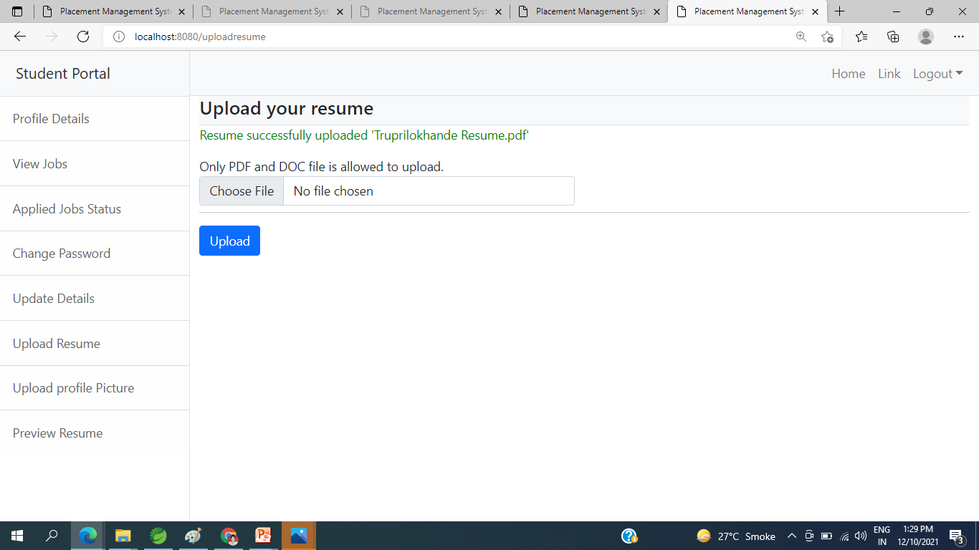
student portal upload RESUME

Slide 19
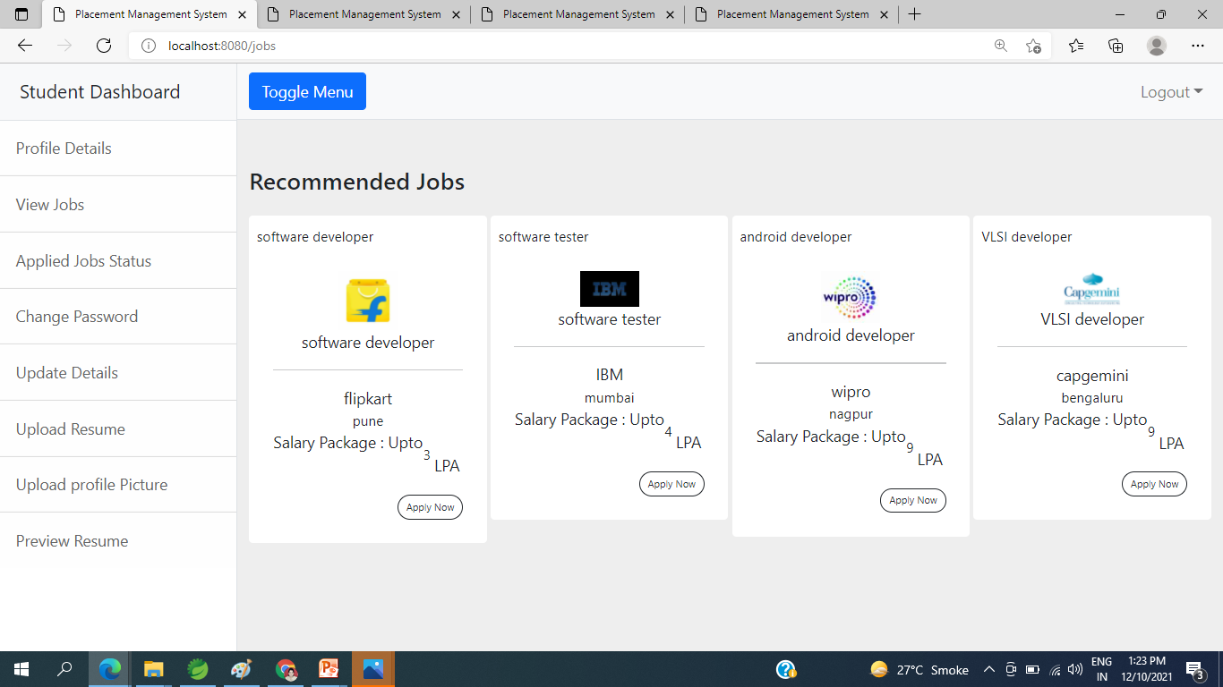
student portal view jobs

Slide 20
PROJECT IMPLEMENTATION
Project Implementation Technology:
The Project is loaded in Spring boot. We used Spring Tool Suite 4 for Design and coding of project. Created and maintained all databases into MySQL workbench8.0.CE in that we create tables, write query to store data or record of project.

Slide 21
conclusion
In this presentation, we explained the system design, requirements and implementation and the modules we have done till now. In accessing the outcome of this System, we have come to the final conclusion that online Placement Management system is more convenient than manual Placement Process.

Slide 22
REFERENCES
SOFTWARE ENGINEERING (Roger s. Pressman)
COMPLETE HTML (Steven Holzner)
WWW.W3SCHOOLS .COM

Slide 23
THANK YOU

